Slide 1

Department of Information Technology
A.P. Shah Institute of Technology
G.B.Road,Kasarvadavli, Thane(W), Mumbai-400615
UNIVERSITY OF MUMBAI
Academic Year 2019-2020

Slide 2
A Project Report on
Title of your project
Submitted in partial fulfillment of the degree of
Bachelor of Engineering(Sem-7)
in
INFORMATION TECHNOLOGY
By
Vinit Shah(17204014)
Mahek Jain(17204010)
Hiral Thadeshwar(17204012)
Under the Guidance of
Rujata Chaudhari
Vishal Badgujar

Slide 3
1.Project Conception and Initiation

Slide 4
1.1 Abstract
.The basic idea behind the paper is to develop a 1/10 scale RC car to portray an automated car. The model consists of the following software and hardware components such as CNN(Convolutional neural network), Monocular vision algorithm, Haar cascade classifier, Raspberry Pi Board model B+, Pi camera, Arduino, and an Ultrasonic sensor. The Pi camera and ultrasonic sensor are attached to the raspberry pi board to collect input images along with sensor data to stream these data to the server which in our case is the laptop. The (CNN)convolutional neural network running on the server will be used to enable lane detection to provide steering predictions that are left, right, forward based on the input image.

Slide 5
1.2 Objectives
To have a driverless car.
To provide user convenience.
To make service available 24*7.
If a practical self-driving car is ever mass produced, the first major change would be to ride services.
Instead of relying on human instincts built up over millions of years that ensure self preservation, a computer will be safer.

Slide 6
1.3 Literature Review
Paper Title: Real-Time Self-Driving Car Navigation Using Deep Neural Network
Authors:Truong-Dong Do, Minh-Thien Duong
Publication details: International Conference on Green Technology and Sustainable Development (GTSD), 2018
Findings: In this paper, they have presented an autonomous car platform based on the softmax function squashes the outputs of each unit to be between 0 and 1, just like a sigmoid function.[1]
Advantages: The system uses only one single camera for all inputs and it drives at about 5-6 km/hr whether the lane markings are present or no.
Disadvantages:This model only detects lane markings and turn signs. It just hovers the car left or right and does not sense signals or stop sign.

Slide 7
1.3 Literature Review
Paper Title: Neural controller of autonomous driving mobile robot by an embedded camera
Authors:Hajer Omrane, Mohamed Slim Masmoudi and Mohamed Masmoudi
Publication details: International Conference on Advanced Technologies For Signal and Image Processing - ATSIP, 2018
Findings: They have build an autonomous RC Car that uses Artificial Neural Network (ANN) for control. It describes the theory behind the neural network and autonomous vehicles[2]
Advantages: Using an embedded pi camera for input and gray scale of images for training in neural network.[4]
Disadvantages:The system detects lane markings for each direction and does not offer any other functionality other than that.

Slide 8
1.3 Literature Review
Paper Title: Driverless Car: Autonomous Driving Using Deep Reinforcement Learning In Urban Environment
Authors:Abdur R. Fayjie, Sabir Hossain, Doukhi Oualid, and Deok-Jin Lee
Publication details:15th International Conference on Ubiquitous Robots (UR) Hawaii Convention Center, Hawai'i, USA, June 27-30, 2018
Findings: In this paper, they have presented a reinforcement-learning based approach with Deep Q Network implemented in autonomous driving.[3]
Advantages: Using fusion of camera and lidar helps in better knowing of the surroundings and all kinds of obstacles.
Disadvantages:They have implemented a model using lidar(laser sensor) which is a very costly sensor and it is applicable for large scale cars.

Slide 9
1.4 Problem Definition
Problem Detected | Solution
Existing cars needs effort to be driven and certain amount of time goes in reaching one destination which could be utilised in some other work. | The existing human driven cars to be replaced by effective self driven cars keeping in mind of various safety conditions. So developing a model scaled car which can be implemented using monocular vision method and technology in an actual car. Implementing machine learning and image processing to gain better knowledge of new technologies. We are creating a prototype to explain the concepts of machine learning which will be helpful to teach the students as it can be presented as the live example of machine learning.

Slide 10
1.5 Scope
Our car will be able to provide automation between level 4 and 5.
Car will be able to detect lane markings, obstacles, traffic signals, stop signs and take decisions accordingly.
To traverse on any road not visited before.
To work in a model environment.

Slide 11
1.6 Technology stack
Raspberry Pi 3
Arduino Nano
OpenCV
Ultrasonic sensor
Pi camera

Slide 12
1.7 Benefits for environment & Society
Autonomous vehicles are also programmed to operate in a more fuel-efficient manner. Human drivers tend to ride the gas and brakes heavier than necessary, which burns excessive fuel. In contrast, self-driving trucks and cars can be programmed to operate at maximum efficiency all the time.
Majority of the self driving cars are implemented on electric cars which result in no emission.
Higher levels of autonomy have the potential to reduce risky and dangerous driver behaviors. The greatest promise may be reducing the devastation of impaired driving, drugged driving, unbelted vehicle occupants, speeding and distraction.

Slide 13
2. Project Design

Slide 14
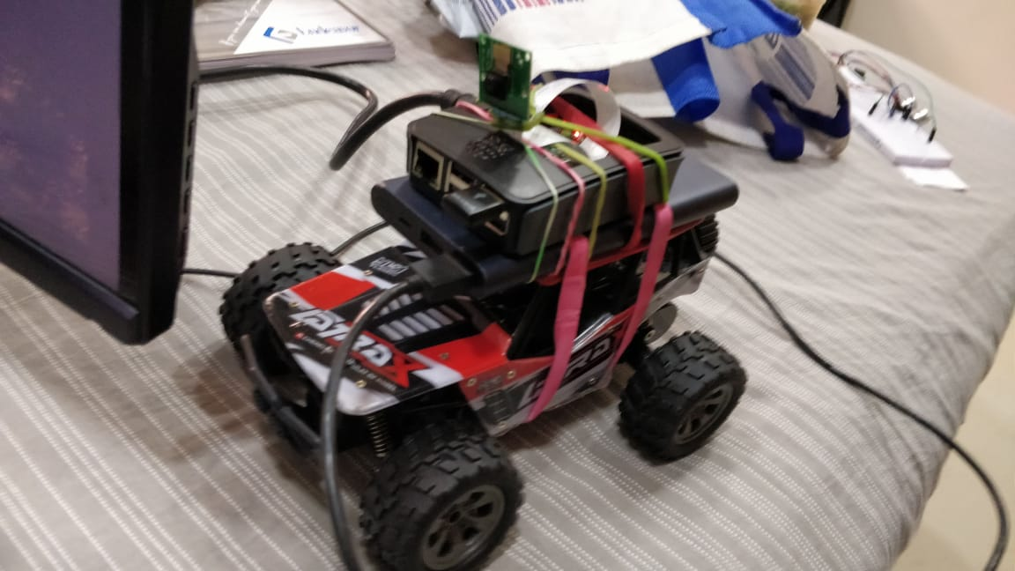
2.1 Proposed System

Slide 15
2.1 Proposed System
This project builds a self-driving RC car using Raspberry Pi, Arduino and open source software.
Raspberry Pi collects inputs from a camera module and an ultrasonic sensor, and sends data to a computer wirelessly.
The computer processes input images and sensor data for object detection (stop sign and traffic light) and collision avoidance respectively.
A neural network model runs on computer and makes predictions
for steering based on input images. Predictions are then sent to the Arduino for RC car control.
The system uses sensor and camera constantly to check for obstacles and safety signs.

Slide 16
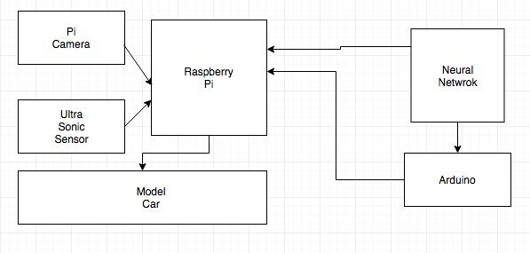
2.1 Proposed System

Slide 17
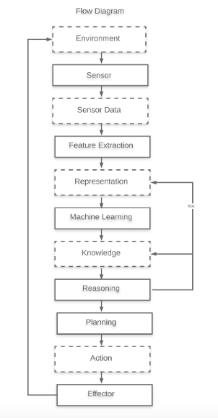
2.2 Design(Flow Of Modules)

Slide 18
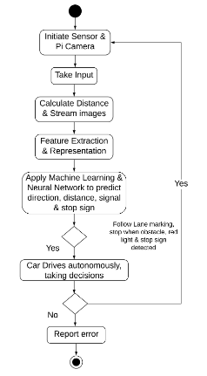
2.3 Activity diagram

Slide 19
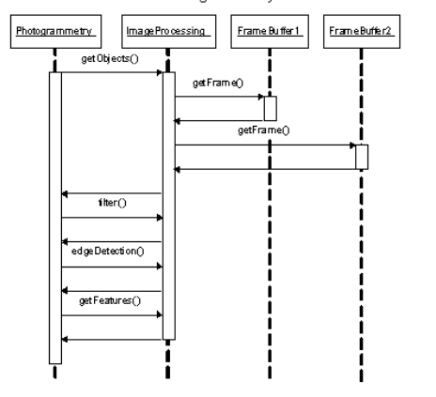
2.4 Sequence Diagram
Image processing

Slide 20
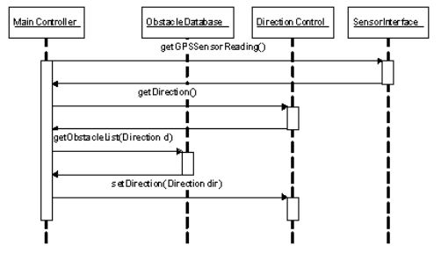
2.4 Sequence Diagram
Direction Prediction

Slide 21
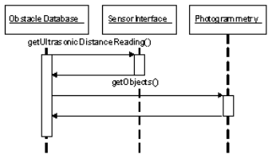
2.4 Sequence Diagram
Obstacle Detection

Slide 22
2.5 Module-1(Input Unit)
A Raspberry Pi board (model B+), attached with a pi camera module and an HC-SR04 ultrasonic sensor is used to collect input data. Two client programs run on Raspberry Pi for streaming color video and ultrasonic sensor data to the computer via local Wi-Fi connection. In order to achieve low latency video streaming, video is scaled down to QVGA (320×240) resolution.

Slide 23
Module-2(Processing Unit)
The processing unit (computer) handles multiple tasks: receiving data from Raspberry Pi, neural network training and prediction(steering), object detection(stop sign and traffic light), distance measurement(monocular vision), and sending instructions to Arduino through USB connection.
TCP Server
A multithread TCP server program runs on the computer to receive streamed image frames and ultrasonic data from the Raspberry Pi. Image frames are converted to gray scale and are decoded into numpy arrays.

Slide 24
Module-3(Neural Network)
One advantage of using neural network is that once the network is trained, it only needs to load trained parameters afterwards, thus prediction can be very fast. Only lower half of the input image is used for training and prediction purposes. There are 38,400 (320×120) nodes in the input layer and 32 nodes in the hidden layer. The number of nodes in the hidden layer is chosen fairly arbitrary. There are four nodes in the output layer where each node corresponds to the steering control instructions: left, right, forward and reverse respectively

Slide 25
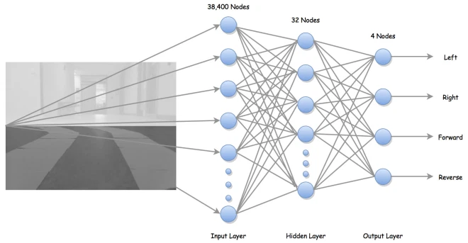

Slide 26

Module-4(Object Detection)
This project adapts the shape-based approach and used Haar feature-based cascade classifiers for object detection. Since each object requires its own classifier and follows the same process in training and detection, this project only focused on stop sign and traffic light detection.
To recognize different states of the traffic light(red, green), some image processing is needed beyond detection. Flowchart below summarizes the traffic light recognition process.

Slide 27
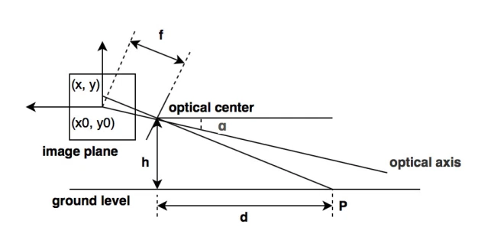
Distance Measurement

Slide 28
2.6 References
[1]Truong-Dong Do, Minh-Thien Duong, Quoc-Vu Dang and My-Ha Le, “Real-Time Self-Driving Car Navigation Using Deep Neural Network” in International Conference on Green Technology and Sustainable Development (GTSD), 2018
[2]Hajer Omrane, Mohamed Slim Masmoudi and Mohamed Masmoudi, “Neural controller of autonomous driving mobile robot by an embedded camera” in International Conference on Advanced Technologies For Signal and Image Processing - ATSIP, 2018
[3]Abdur R. Fayjie, Sabir Hossain, Doukhi Oualid, and Deok-Jin Lee, “Driverless Car: Autonomous Driving Using Deep Reinforcement Learning In Urban Environment” in 15th International Conference on Ubiquitous Robots (UR) Hawaii Convention Center, Hawai'i, USA, June 27-30, 2018
[4]F. Shumaila Mateenuddin, Mrs. V.S. Jahagirdar, "An Android Controlled Mini Rover for real time surveillance using Raspberry Pi 3", in International Journal Of Advanced Research in Engineering & Management (IJAREM), 2017.

Slide 29
3. Conclusion and Future Scope

Slide 30
Automation in cars in real world is a very big field, where many sensors come into action, our idea is to solve many of those into two sensors by detecting distance and objects like stop sign, signals and other obstacles with a single method of monocular vision which can be enhanced in future from a scaled car to an actual car. The prototype focuses on these functionalities which we are developing in a model rc car while others focus on only one aspect of it.

Slide 31
Paper Publication
Paper Title: Artificial Intelligence Based Self Driving Car
Authors: Vinit Shah, Hiral Thadeshwar, Mahek Jain, Rujata Chaudhari, Vishal Badgujar
Publication Details: Communication and Signal Processing, ICCCSP 2020

Slide 32
Thank You

